Slide 1




ACCS Wales: Who’s Who & an Overview
September 2024
Louise Allman, ACCS Tpd

Slide 2
72 ACCS Trainees in Wales:
36 Emergency Medicine, 32 Anaesthetics, 4 Acute Medicine
North: YG, WM
South: GUH, C & V, POW, PCH, Morriston

Slide 3
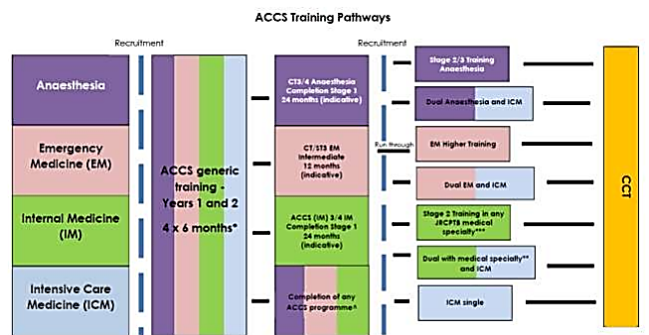

Slide 4

Specialty Leads
Hospital Leads
Ash Basu
HoS ACCS & EM,
ED Consultant, Wrexham
Craig Planello
EM & Education Lead
POW
Ash Basu
Wrexham Lead
Terry Collingwood YG Lead
Anaes Consultant
Craig Planello
POW Lead
Liz Babbage
Specialty Training Manager, HEIW
Natalie Mincher
Anaes Lead
ABUHB
Hospital Site Trainee Reps
Natalie Mincher
ABUHB Lead
Lucy Cunnane
PCH Lead EM Consultant
John Hounsell
IM Lead
POW
Louise Allman
TPD ACCS yrs 1 & 2
Anaes Consultant ABUHB
Nathan Tweed Morriston Lead
Anaes Consultant
Duncan Thomas UHW Lead
EM Consultant
Sonia Sathe
ICM Lead
POW

Slide 5

trainee reps
Aneurin Bevan: Helena Pugh (EM ST2)
Cardiff & Vale: oskar Mahony (Anaes Ct2)
Morriston: Luca Galvani (anaes CT2)
Princess of wales: Nathan Anderson (EM ST2)
Prince Charles: Lewys Thomas (EM ST2)
Ysbyty Gwynedd: Luke Mueller (EM ST2)
Wrexham: Rebecca Williams (ANAEs CT2)

Slide 6
Educational Supervisors
Placement Educational Supervisor (CS)
EM TPD
Rhian Farquharson
IM TPDs
Inder Singh
Rhian Bartle
ARCP Manager & Deputy Training Manager
HEIW School Support
Professional Support Unit
Royal College / Faculty Tutors in departments
Health Board Faculty Tutors, Medical Directors of Education, PG Centres
Anaes TPD
Mike Adamson
ICM TPD
John Glen

Slide 7

ES vs Placement ES: Why have both?
Placement Educational Supervisor (clinical supervisor)
- 1 for each 6 month specialty placement : AIM, ICM, EM, ANAES
- responsible for overseeing placement in that department
- meetings: initial, mid-point and end > End of Placement Report
- Initial meeting: confirm dept. induction taken place and answer any outstanding queries from this, PDP, placement-specific LOs, LO5 Skills, LOs 9-11- inform of any local and dept. resources. Set expectations (conduct, contact, communication, engagement.) Evidence expected in placement (MSF each placement, MCR/MTR each placement (2 FEGs). EDT (when, where, resources, documentation and map to PDP)

Slide 8

Educational Supervisor
One ES for the 2 year programme
From parent specialty
Oversees overall progression and development over the 2 years
MSF
Generic LOs 9, 10, 11: making ‘satisfactory progress’
Liaise with CSs in each placement, communicate any issues or queries
Liaise with site lead>specialty lead>TPD/HoS/Specialty Manager

Slide 9
ES: when to request meetings
Initial
Mid-year (January)
Pre-arcp planning meeting (beginning of may)
4. End of year
to Write End of Year Report – ESR/ESSR (avail. On ris-r & rcptrb but LLP one is not good enough*)

Slide 10
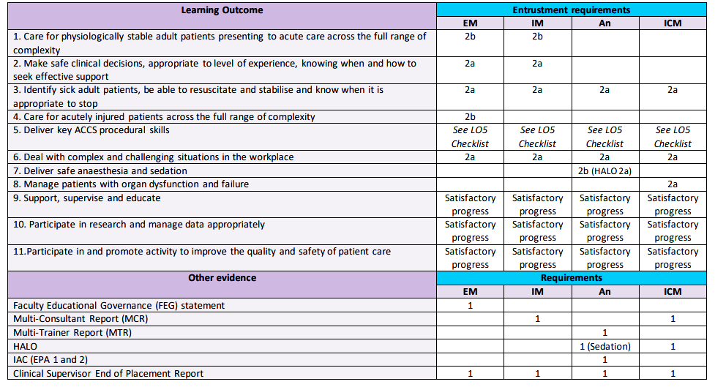

Slide 11
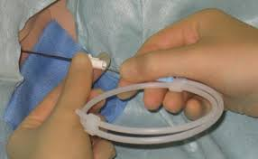
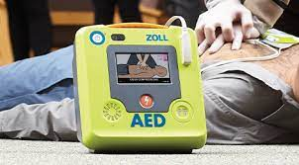
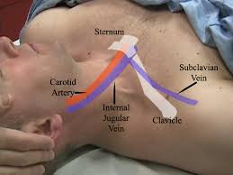
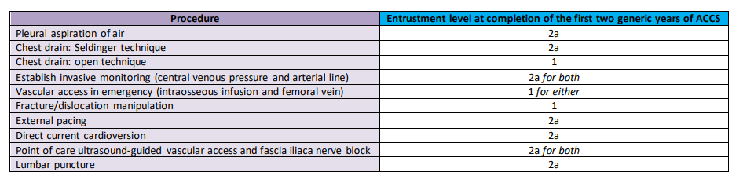
LO5: Practical Skills
Notes:
Pleural aspiration air/fluid, part of ICD procedure
E-learning, Skills Days, hospital sim suite, life support courses

Slide 12





Resources:
ICACCST. National ACCS website www.accs.ac.uk

Slide 13




Royal College websites/ National bodies
www.rcoa.ac.uk Anaesthetics
www.rcem.ac.uk Emergency Medicine
www.jrcptb.org.uk Internal Medicine, www.acutemedicine.org.uk Society for Acute Medicine
www.ficm.ac.uk Intensive Care

Slide 14

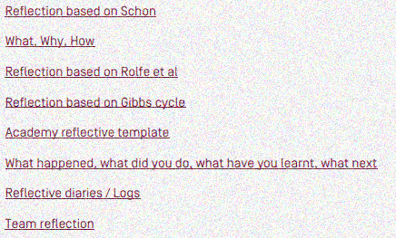
Reflection Templates:
Reflective_Practice_Toolkit_AoMRC_CoPMED_0818.pdf

Slide 15




Specialty Societies in Wales
Welsh Intensive Care Society (WICS) www.welshics.org
Welsh School of Anaesthesia, ICM and pain medicine: www.welshschool.co.uk
Welsh Acute Physicians Society www.acutemedwales.org.uk All ACCS IM trainees automatically members & invited to SpR annual training week ☺

Slide 16
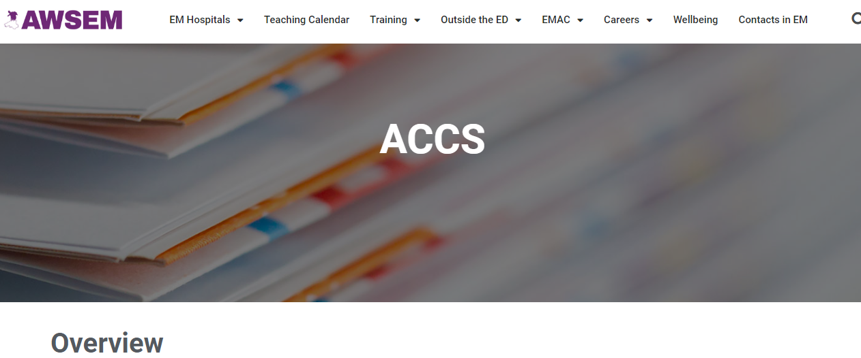

All Wales Society of Emergency Medicine awsem.co.uk/accs
ACCS Wales Handbook, Presentations from ACCS Leads

Slide 17
ACCS ARCPs
What do you need to know?

Slide 18



ARCP- Annual Review of Competence Progression
The format and outcomes for ARCP are based upon guidance from ICACCST, HEIW and the Gold Guide
NB New edition of Gold Guide released Aug ‘24

Slide 19
ARCP Outcomes
Progressive Outcome:
1: Satisfactory progress
Developmental Outcomes:
2: Development of specific capabilities required- Additional training not required
3: Insufficient progress – Additional training time required
4: Released from training programme
5: Incomplete evidence presented – An assessment of progression can’t be made
- Agree what outstanding evidence is required and the timescale (days to weeks) in which it must be provided to be able to issue an outcome (SMART)
Notes:
Highlight that 10.2 should only be used at a critical point such as CCT.

Slide 20

ARCP: how to prepare
The ARCP is a formal process that reviews evidence presented by
the trainee and their ES relating to the trainee’s progress since their last ARCP. The review looks at the amount and quality of the evidence to determine whether a trainee should move on to the next part of their training, or whether additional training experience or time is required. For a full explanation www.copmed.org.uk/publications/gold-guide/gold-guide-10th-edition
WHEN: July 7-10th 2025
WHY not later? (Gold Guide allow them to be up to 12 weeks before end of year.)
1. Know what is expected of you now – Read ARCP Decision Aid, Curriculum, End of placement/ ESR forms
2. Keep e-portfolio up-to-date: Aim MINIMUM 1 wpba per week. Trainees that struggled at ARCP showed evidence of poor portfolio/supervisor engagement all year.
3. ASK FOR HELP: Other trainees, ES, CS, PSU. If still unclear, ask someone else e.g. TPD

Slide 21
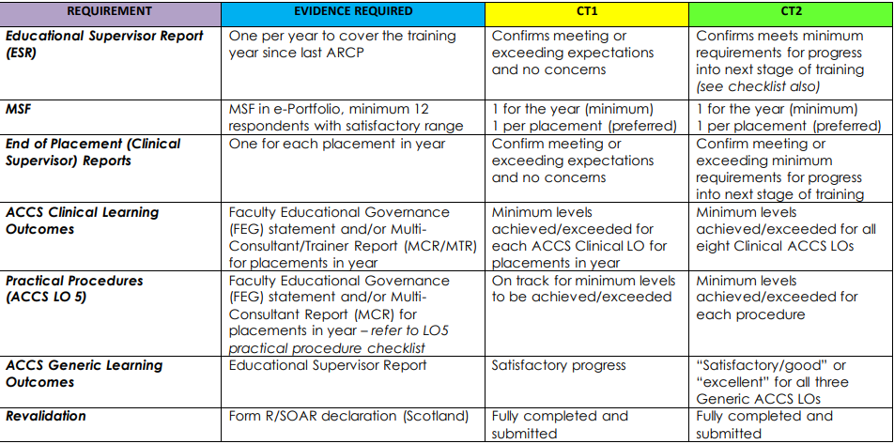

ARCP Guidance Table 2024-25

Slide 22


MSF
1 1 1 1

Slide 23
LO5: Practical Skills
Notes:
Pleural aspiration air/fluid, part of ICD procedure
E-learning, Skills Days, hospital sim suite, life support courses

Slide 24

Entrustment levels
Level 1: Direct supervisor observation/involvement, able to provide immediate direction or assistance
Level 2a: Supervisor on the ‘shop-floor’ (e.g. ED, theatres, AMU, ICU), monitoring at regular intervals
Level 2b: Supervisor within hospital for queries, able to provide prompt direction or assistance and trainee knows reliably when to ask for help
Level 3: Supervisor ‘on call’ from home for queries, can provide directions via phone and can attend the bedside if required to provide direct supervision
Level 4: Would be able to manage with no supervisor involvement (all trainees’ practice with a consultant taking overall clinical responsibility)

Slide 25

How to Prepare for ARCP
Good preparation is key to a successful ARCP. Tips to achieving this are:
STEP 1: Know what is expected of you now – Read ARCP Decision Aid, Curriculum, End of placement/ ESR forms
STEP 2: Keep e-portfolio up-to-date: Aim MINIMUM 1 wpba per week. Trainees that struggled at ARCP showed evidence of poor portfolio/supervisor engagement all year.
STEP 3: Meet with your ES and CSs throughout the year and ensure meetings are documented in eportfolio. Run through ARCP Requirements Table together so you can plan what you have left to do
STEP 4: Plan your Faculty Reports (FEG/ MTR/ MCR) and MSFs early: Month 3-4
STEP 5: CS End of Placement meetings and review month 5: book meeting early
STEP 6: ES needs CS report, MSF and Faculty Reports completed before final End of Year ES meeting, to do ES Report: THE key document that ARCP panel use.
STEP 6:Form R part B, WSOP declaration- Signed WSOP forms for any paid or unpaid work done outside of your ACCS rotation. Complete and upload copies to eportfolio in ARCP folder
STEP 7: Completed reports eportfolio with an ARCP folder with evidence needs to be for review before deadline of 7 DAYS before ARCP (14 days for Form R)

Slide 26


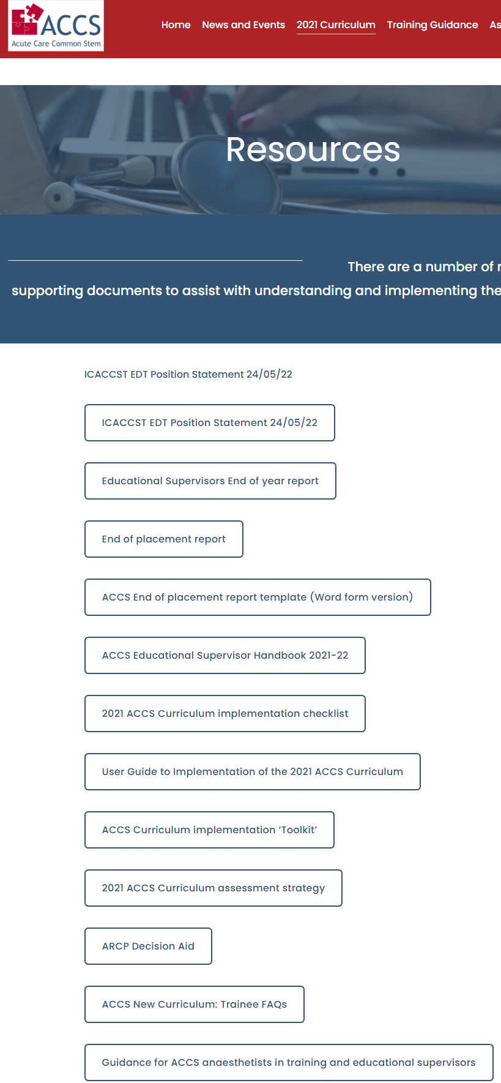
www.accs.ac.uk

Slide 27
End of year Supervisory report (ESR/ESSR)- excerpt

Slide 28
Supervisor meeting: template
Embedded in EM and IM eportfolios, not LLP yet
ACCS WALES CS and ES meeting templates on AWSEM website- mapped to curriculum
www.awsem.co.uk/accs

Slide 29


Example of an ACCS trainee calendar
August: HB and department Inductions
Mandatory Training
Register with parent Royal College/ Set up e-portfolio account
Make contact with your CS and ES and arrange an initial meeting. Document all
meetings on eportfolio
Book study leave/annual leave for placement/ year, incl exam leave and ACCS Study
Days
Sept: ACCS Wales Induction- complete online pre-reading & attend in person
October: Mid-point placement with CS.
Generate MSF with ES, and Faculty Report with CS* (MTR or MCR or FEG)
21st Cardiology study day
Notes:
Remember to check ‘Teaching Calendar’ on AWSEM website for up to date Study Day dates
*clarify who (trainee or supervisor) generates which form e.g. Anaes CS generates MTR on LLP, but you generate MSF

Slide 30




November: 7th - QI Study Day (virtual, HEIW)
18th SW & NW Respiratory Study days
December: 2nd NW Diagnostics Study day
12th SW Diagnostics Study day
January: ** End of Placement Meeting with CS**
* Mid year meeting with ES *
30th SW & NW Management Study day
February: ** Initial new CS meeting**
NW USS Skills day
March: 3rd NW & SW Shock and Sepsis Study days
April: 7th NW & SW Critical Care Study days

Slide 31


May: ** Pre- ARCP planning meeting with ES **
** Send out MSF and Faculty reports (FEG, MTR, MCR)**
** Confirm meeting date with ES and CS for end of year sign-off in June**
June: 4th NW & SW Trauma Study Days
Complete outstanding LOs
** End of Placement CS meeting**
** End of year ES meeting- ACCS ESR**
** Deadline to complete portfolio and submit Form R, incl. WSOP form**
July: ARCP week
Acknowledge receipt of ARCP outcome on portfolio*

Slide 32
Take home points
Immerse yourself in each specialty
Be curious
Take responsibility for arranging Supervisor meetings, asking for assessments, asking for feedback and keeping your eportfolio up to date
Develop Teamwork skills, learning from others, MDT working, develop leadership skills
Ask: peers, reps, Supervisors,Site Lead, Specialty Lead, TPD, Liz B, HoS
HEIW-PSU
Time mgmt: life events and exams

